Slide 1
KEY LOGGER PROJECT
Presented By:
S.Sivabharathi –III CSE- Vetri Vinayaha College of Engineering and Technology

Slide 2
OUTLINE
Problem Statement
Proposed System/Solution
System Development Approach
Algorithm & Deployment
Result (Output Image)
Conclusion
Future Scope
References
6233 - VETRI VINAYAHA COLLEGE OF ENGINEERING AND TECHNOLOGY ,THOTTIAM , TRICHY

Slide 3
PROBLEM STATEMENT
Example: In today's digital age, where cybersecurity threats loom large, one of the significant concerns is the proliferation of keyloggers, stealthy software tools designed to monitor and record keystrokes on a user's computer without their knowledge. Keyloggers pose a severe threat to individuals and organizations as they can capture sensitive information such as passwords, credit card details, and other personal data, leading to identity theft, financial loss, and privacy breaches.
6233 - VETRI VINAYAHA COLLEGE OF ENGINEERING AND TECHNOLOGY ,THOTTIAM , TRICHY

Slide 4
WHAT IS KEYLOGGER
Keylogger is one kind of surveillance technology that is used to monitor and capture keystrokes of a specific device
It can work from both hardware and software
6233 - VETRI VINAYAHA COLLEGE OF ENGINEERING AND TECHNOLOGY ,THOTTIAM , TRICHY

Slide 5
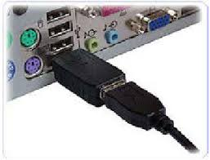
HARDWARE KEYLOGGER
Physical Placement
Stealth and Detection Avoidance
Versatility and Persistance
6233 - VETRI VINAYAHA COLLEGE OF ENGINEERING AND TECHNOLOGY ,THOTTIAM , TRICHY

Slide 6
PROPOSED SOLUTION
In Proposed system we using keylogger files using python libraries and get the date from target user without their knowledge
Python Software
Python Source Code
Run the Code
Results are stored in Keylogger.txt file
Gathering keys from the user
To Start Keylogger
6233 - VETRI VINAYAHA COLLEGE OF ENGINEERING AND TECHNOLOGY ,THOTTIAM , TRICHY

Slide 7
SYSTEM REQUIREMENTS
Python IDLE (Python 3.12.3 version)
Python Commands & Libraires Files
pip install pynput
pip install jsonlib
6233 - VETRI VINAYAHA COLLEGE OF ENGINEERING AND TECHNOLOGY ,THOTTIAM , TRICHY

Slide 8
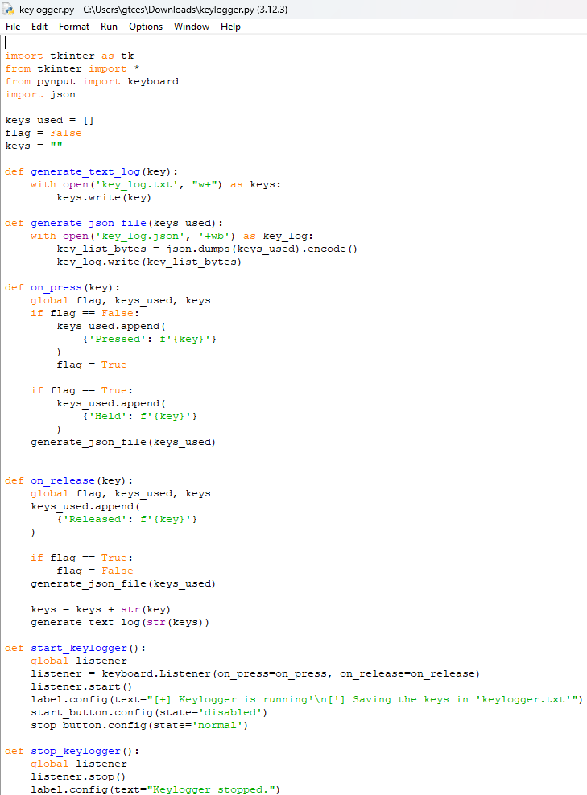
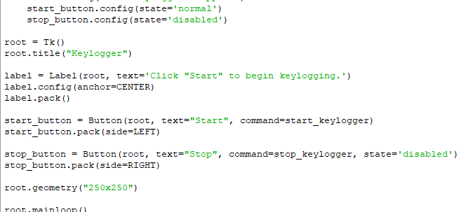
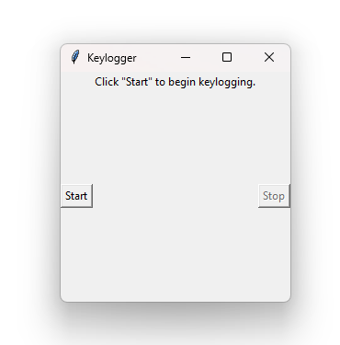
ALGORITHM & DEPLOYMENT
6233 - VETRI VINAYAHA COLLEGE OF ENGINEERING AND TECHNOLOGY ,THOTTIAM , TRICHY

Slide 9
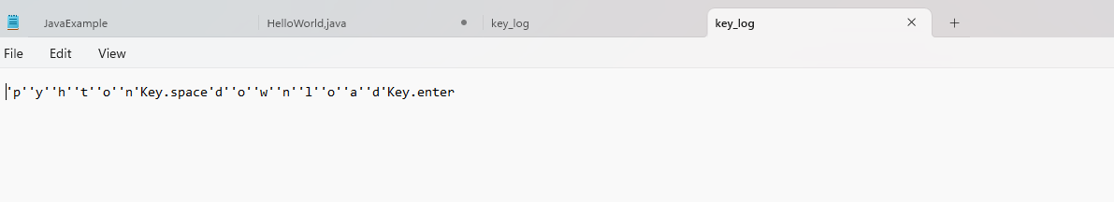
RESULT
6233 - VETRI VINAYAHA COLLEGE OF ENGINEERING AND TECHNOLOGY ,THOTTIAM , TRICHY

Slide 10
CONCLUSION
The final conclusion is using keylogger we are monitor the parental software and law enforcement without target’s user knowledge .
6233 - VETRI VINAYAHA COLLEGE OF ENGINEERING AND TECHNOLOGY ,THOTTIAM , TRICHY

Slide 11
FUTURE SCOPE
Parental Monitoring
Employee Monitoring
Law Enforcement and Investigations
6233 - VETRI VINAYAHA COLLEGE OF ENGINEERING AND TECHNOLOGY ,THOTTIAM , TRICHY

Slide 12
THANK YOU

